Slide 1
Assignment 2
October, 2016
Assignment Introduction
Marco Kuhrmann

Slide 2

What you’ll have to do…
You’ll get a checklist…
Before we start:
Fill-in the pre-project survey…
When the survey is done:
We briefly discuss the checklist
We distribute the task Don’t look at it now!
Now, go to BlackBoard…

Slide 3
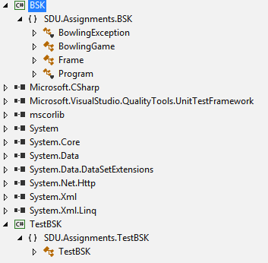
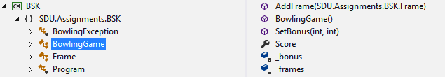
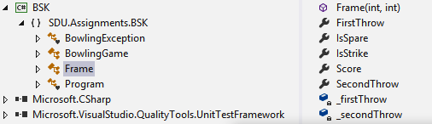
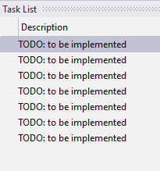
On BlackBoard…
You’ll find a zipped Visual Studio project containing the scaffold…
It contains a TODO-list, here is room for your solution…
Don’t change classes, methods, etc.!
You may add helpers, but keep the given signatures…

Slide 4




The Task…
When we give the “Go”, you have 2 Hours to work on the task…
And now: If you have questions:
Ask us!
(not the neighbor)

